Slide 1
How oxy handles ad group
jUNE 2026
Paul Liu

Slide 2
Create a new ad group

Slide 3
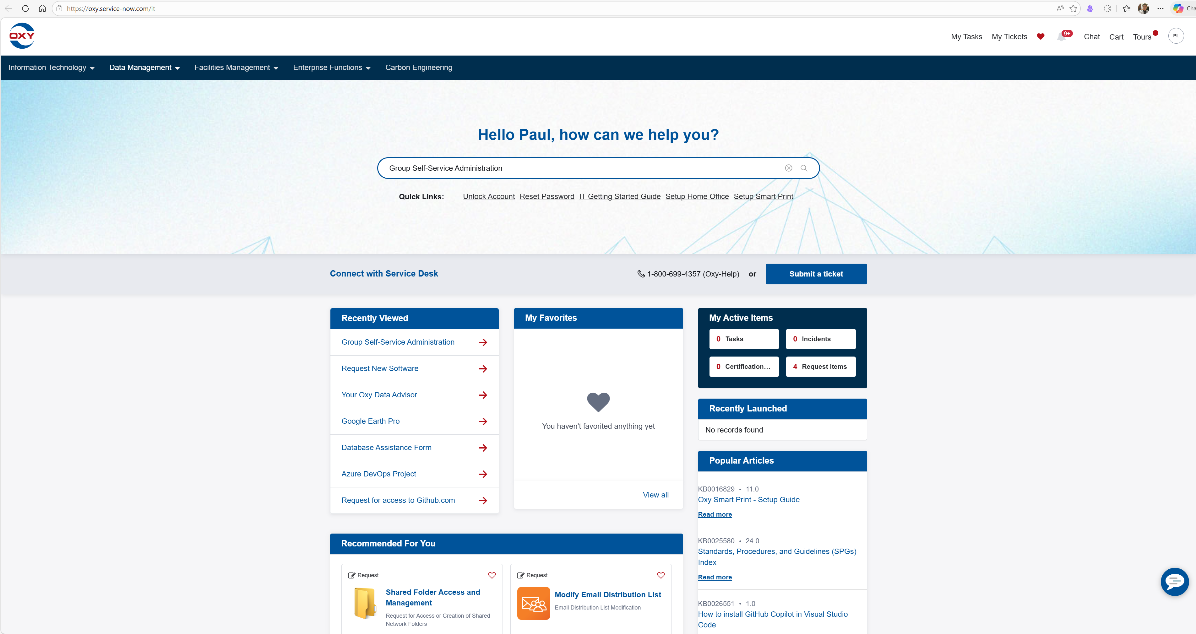
Search “Group self-service administration”

Slide 4
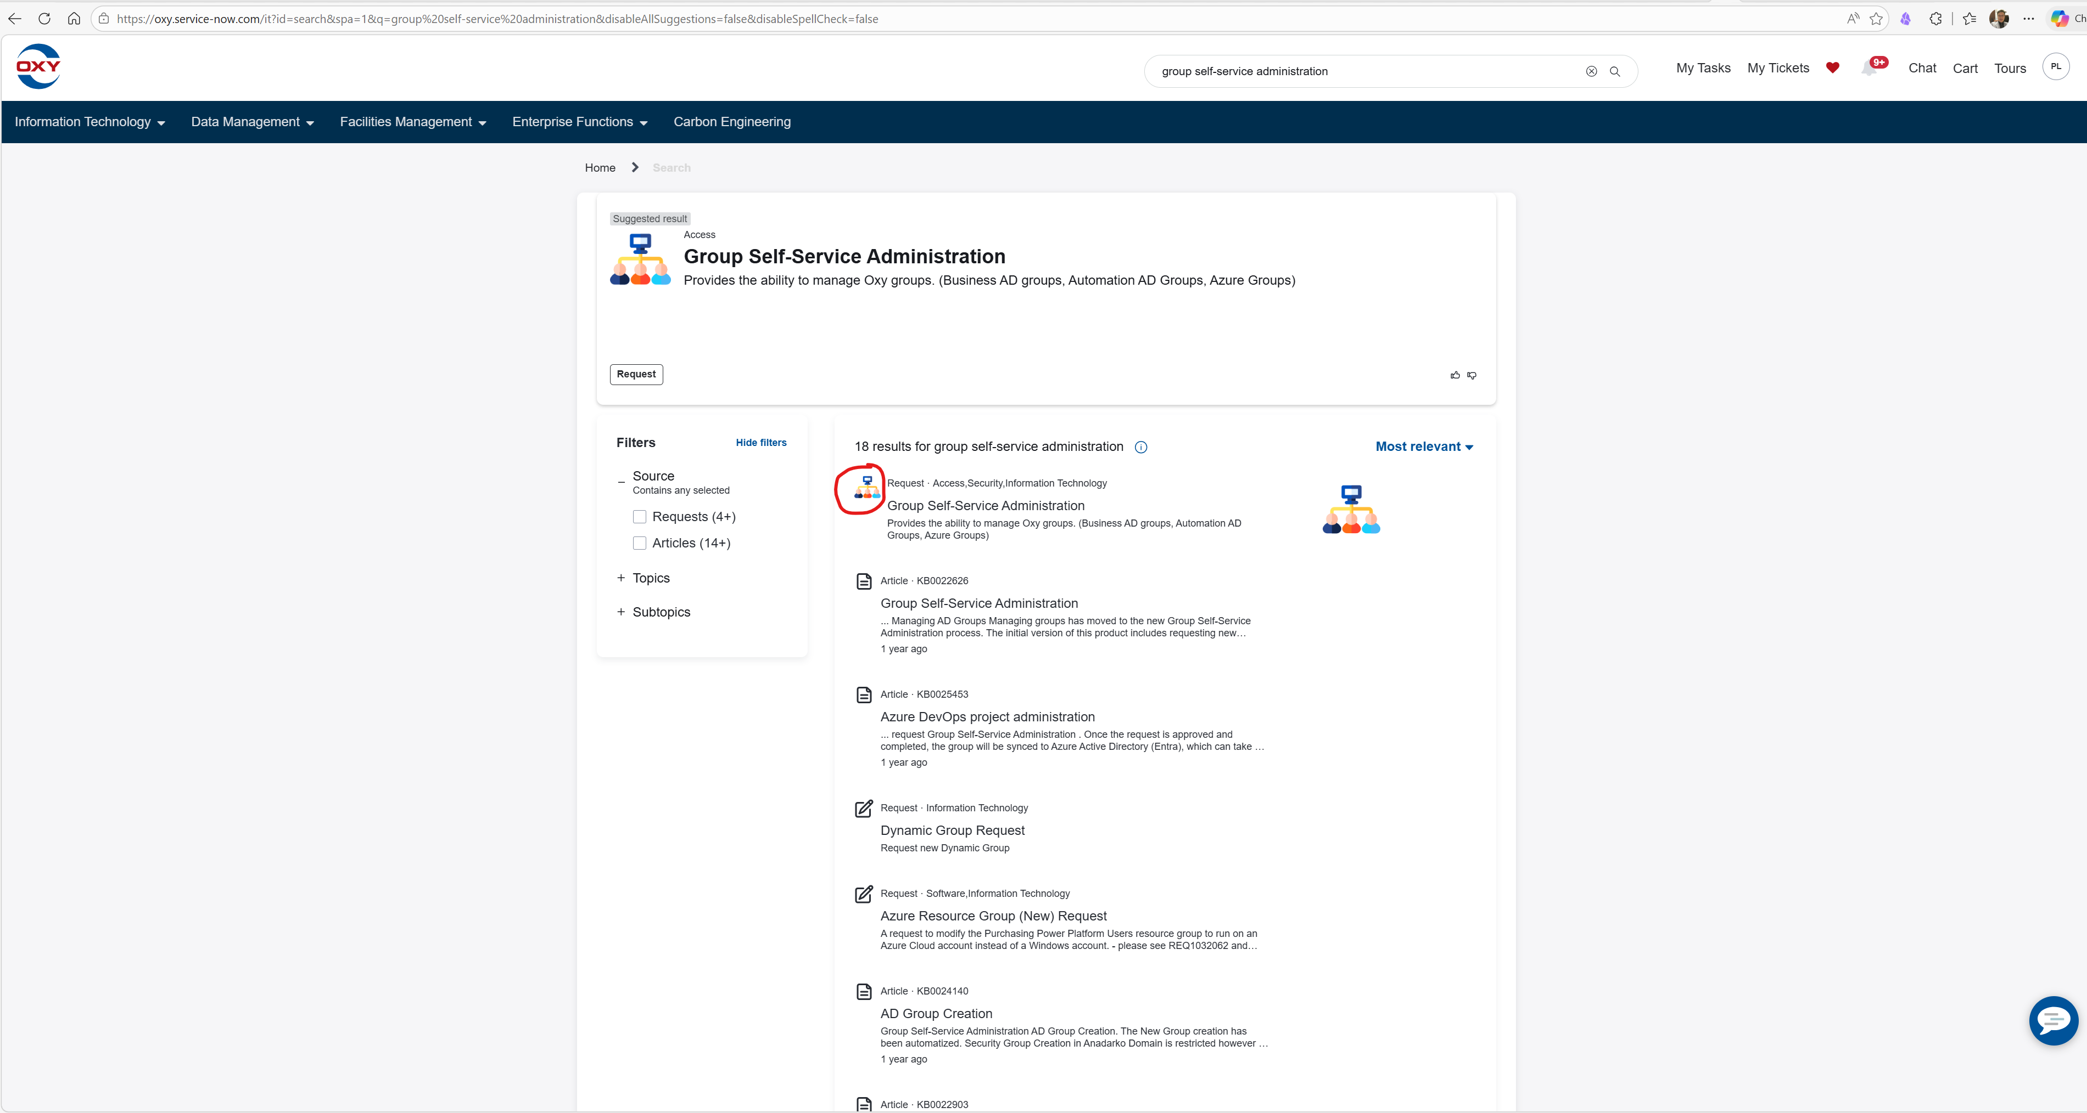

Slide 5
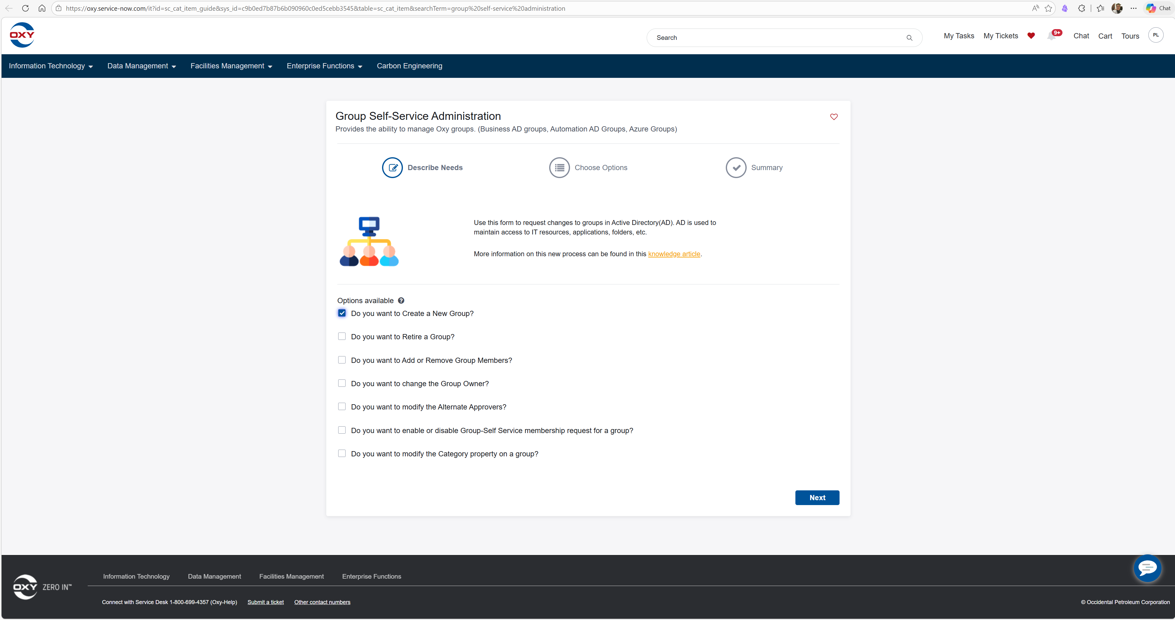

Slide 6
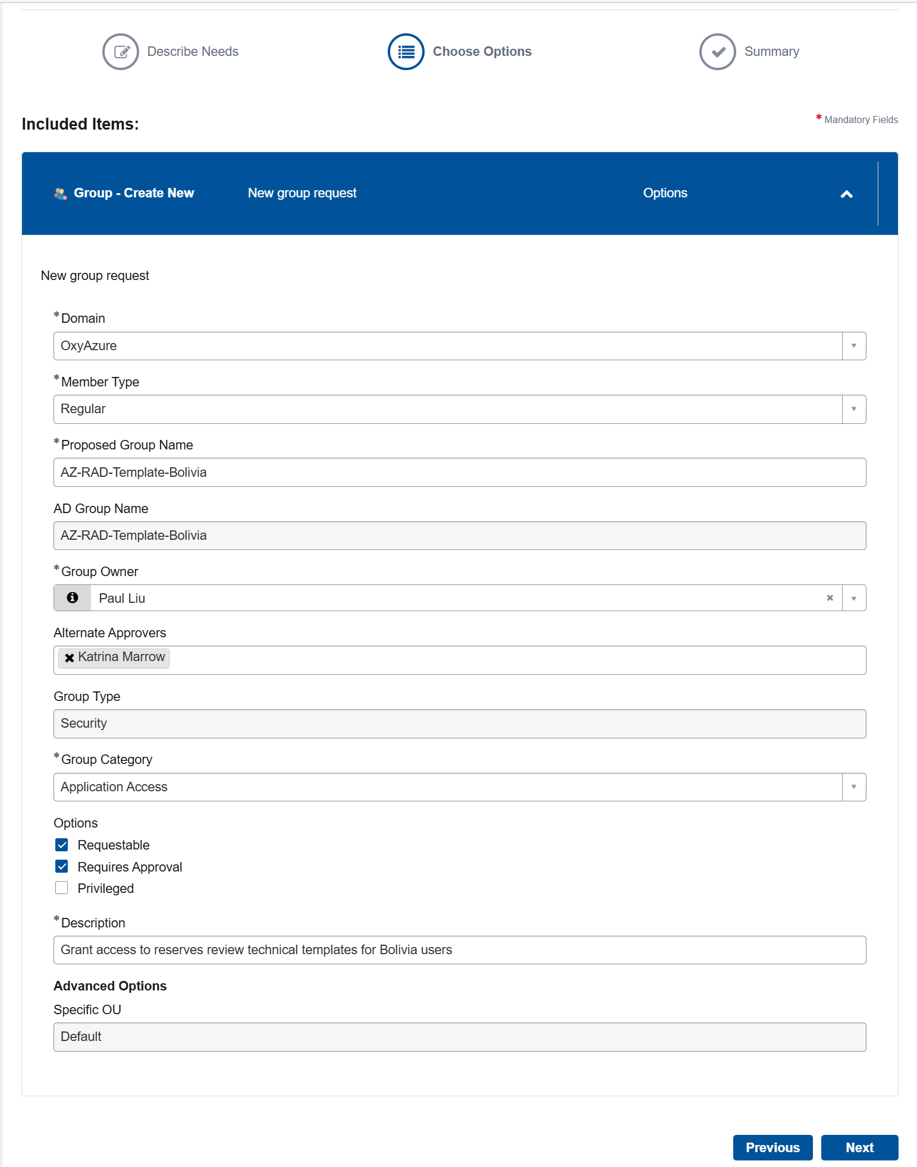
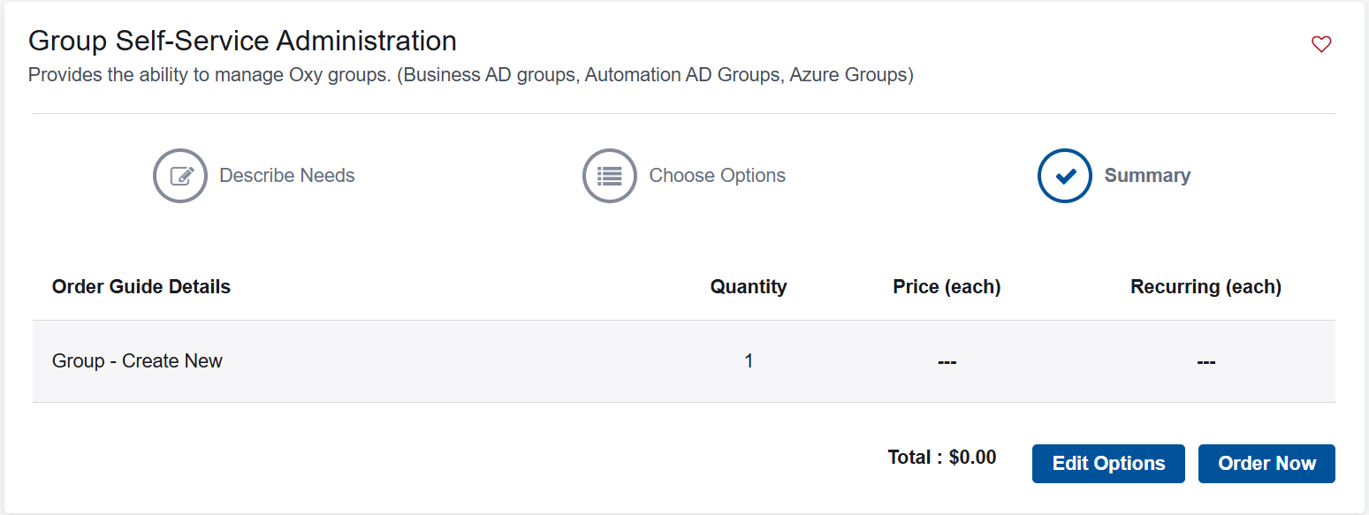
Suggest BURC
Jennifer
Katrina

Slide 7
Add a new member to an ad group

Slide 8
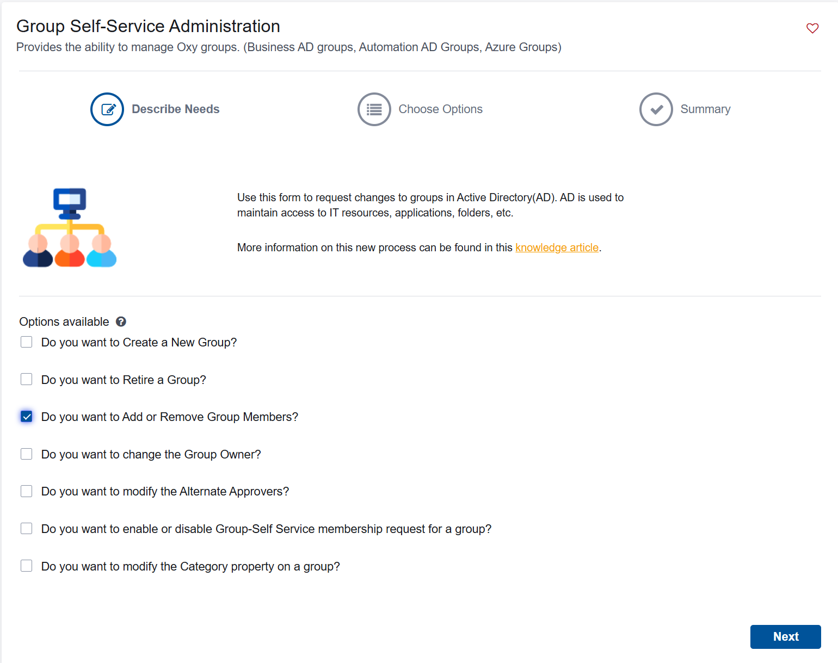

Slide 9
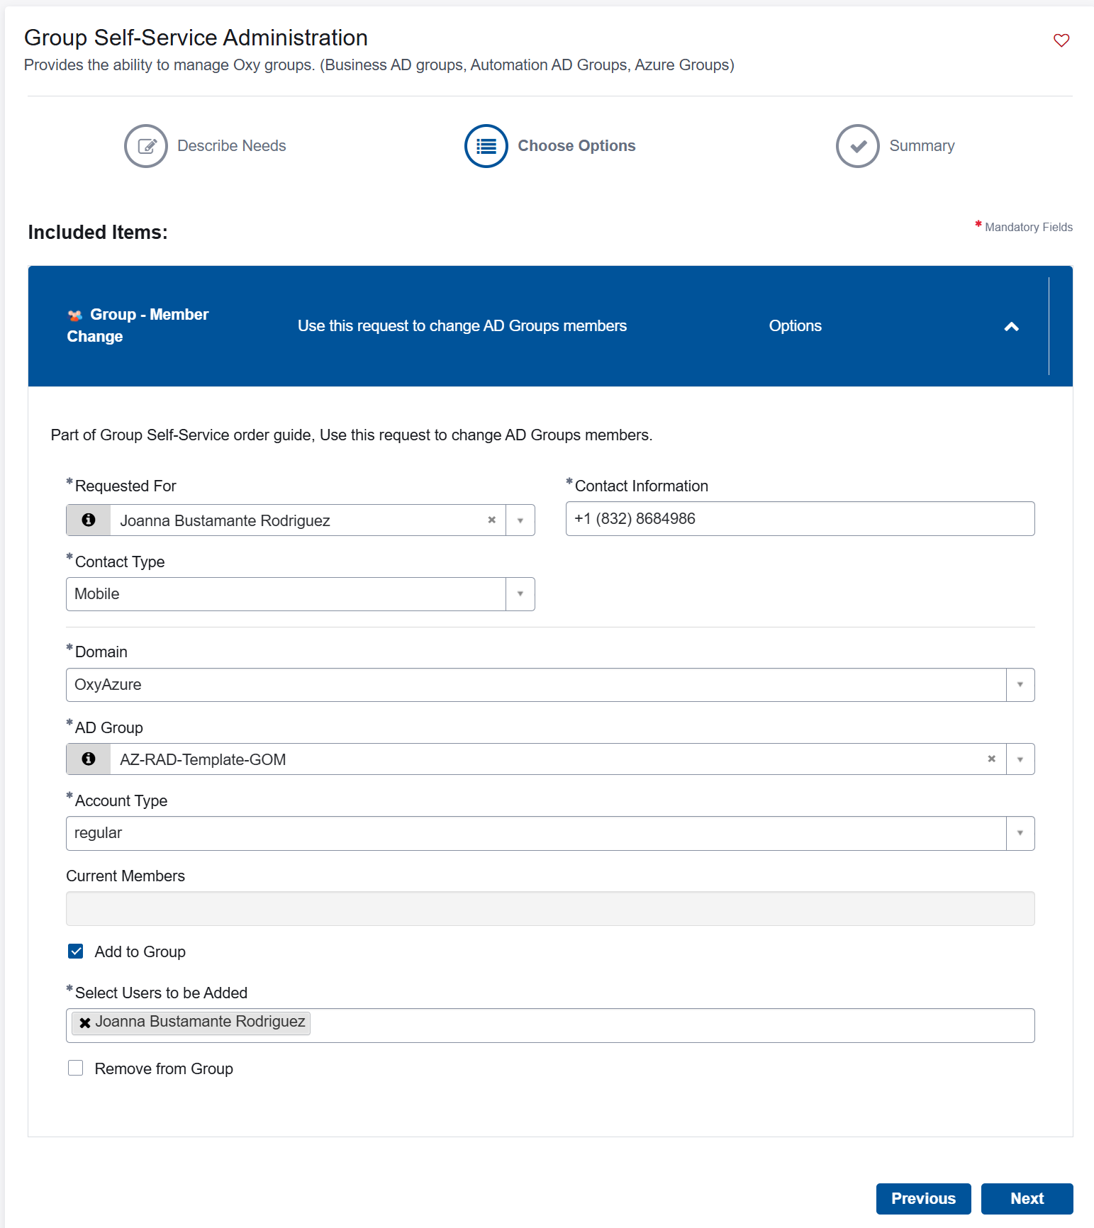
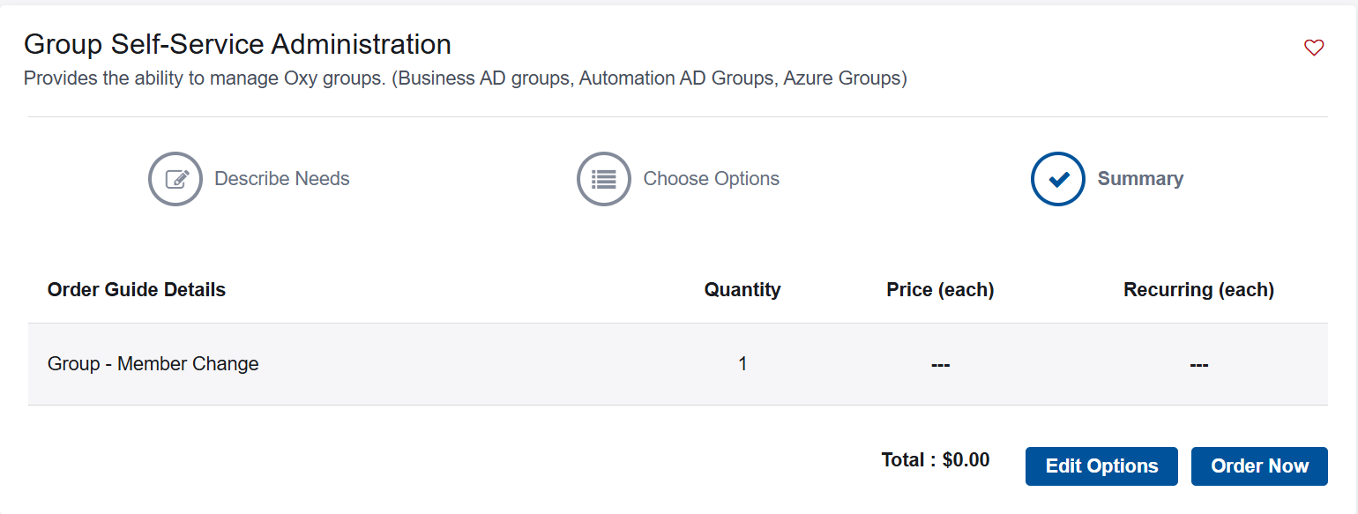
Applicant or anyone being invited

Slide 10
Check ad group id in azure

Slide 11
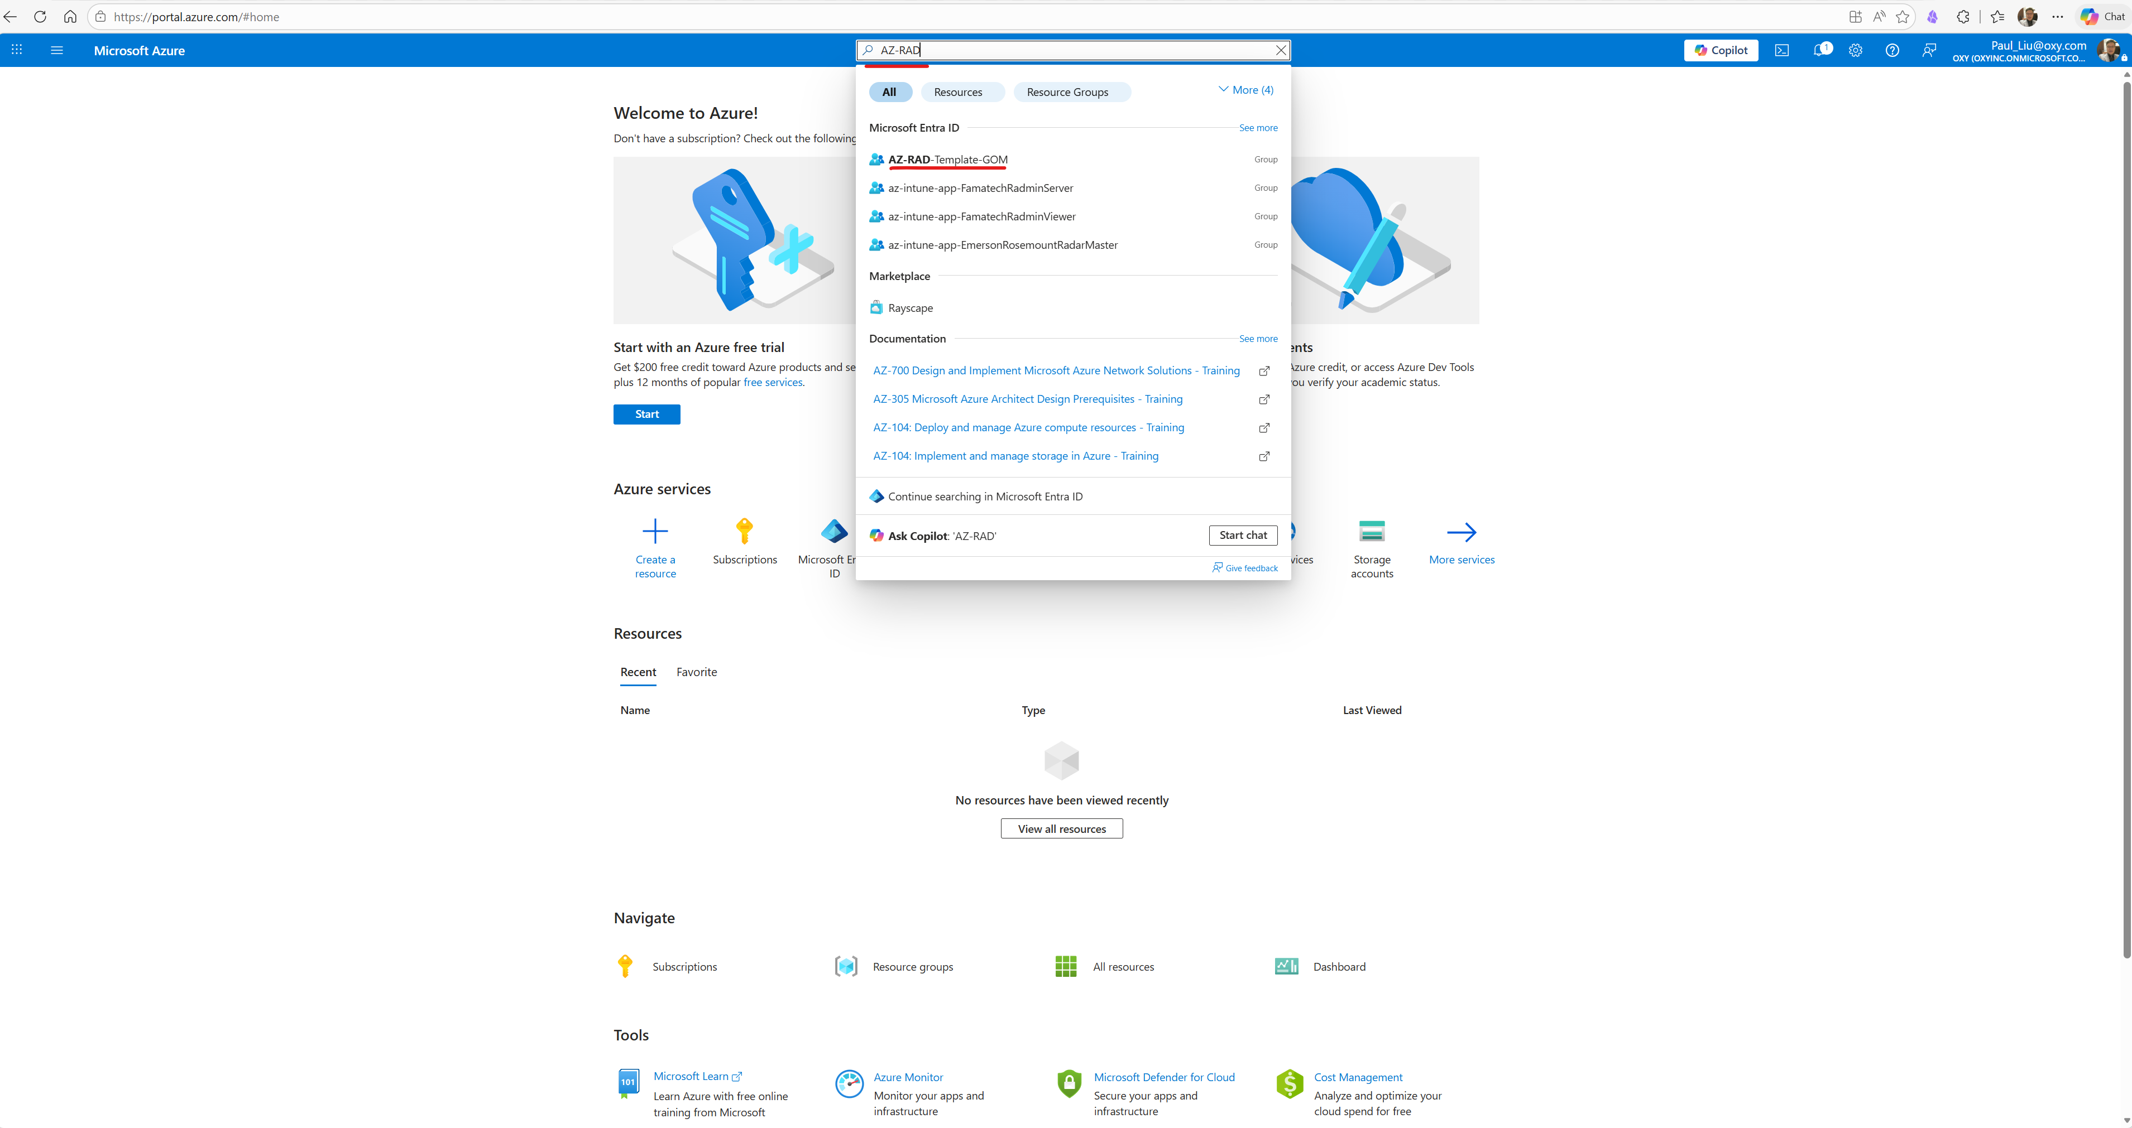

Slide 12
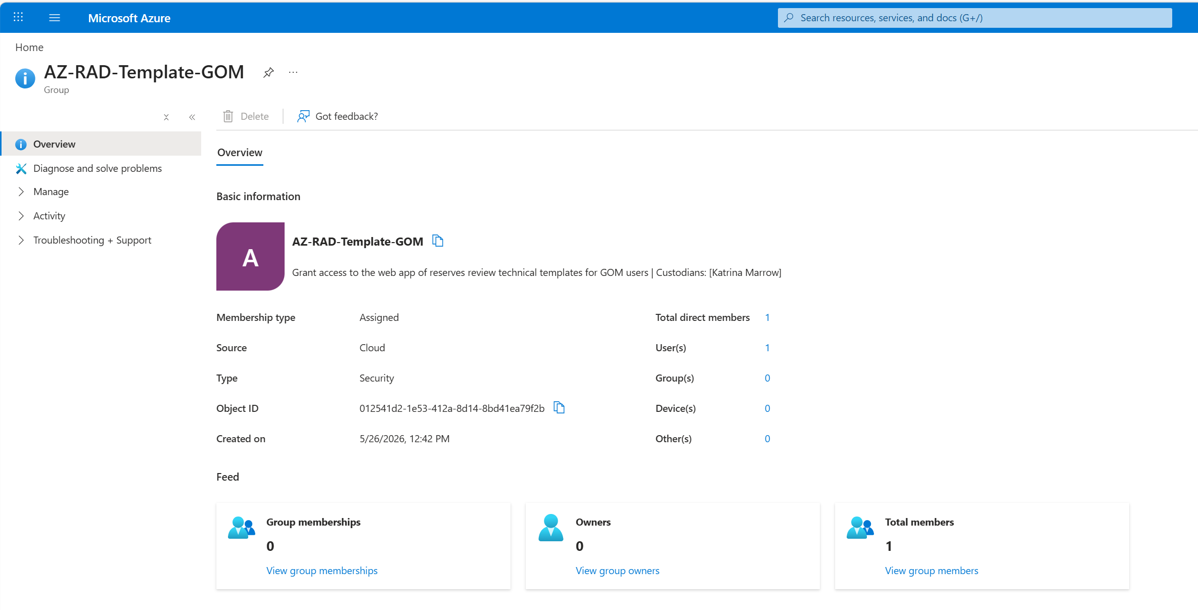
ID is used in code

Slide 13
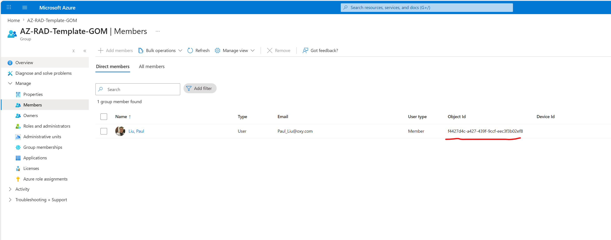

Slide 14
Get object id

Slide 15
AD Groups
az-ACE-Reserves-Algeria-prod
az-ACE-Reserves-Bolivia-prod
az-ACE-Reserves-Dolphin-prod
az-ACE-Reserves-UAE-prod
az-ACE-Reserves-GOM-prod
az-ACE-Reserves-Oman-prod
az-ACE-Reserves-PermianEOR-prod
az-ACE-Reserves-PermianResources-prod
az-ACE-Reserves-Rockies-prod
az-ACE-Reserves-Corporate-prod
az-ACE-Reserves-DolphinandUAE-prod
az-ACE-Reserves-IntlGOM-prod
az-ACE-Reserves-ORCM-prod
az-ACE-Reserves-Algeria-dev
az-ACE-Reserves-Bolivia-dev
az-ACE-Reserves-Dolphin-dev
az-ACE-Reserves-UAE-dev
az-ACE-Reserves-GOM-dev
az-ACE-Reserves-Oman-dev
az-ACE-Reserves-PermianEOR-dev
az-ACE-Reserves-PermianResources-dev
az-ACE-Reserves-Rockies-dev
az-ACE-Reserves-Corporate-dev
az-ACE-Reserves-DolphinandUAE-dev
az-ACE-Reserves-IntlGOM-dev
az-ACE-Reserves-ORCM-dev
az-ACE-Reserves-Algeria-stage
az-ACE-Reserves-Bolivia-stage
az-ACE-Reserves-Dolphin-stage
az-ACE-Reserves-UAE-stage
az-ACE-Reserves-GOM-stage
az-ACE-Reserves-Oman-stage
az-ACE-Reserves-PermianEOR-stage
az-ACE-Reserves-PermianResources-stage
az-ACE-Reserves-Rockies-stage
az-ACE-Reserves-Corporate-stage
az-ACE-Reserves-DolphinandUAE-stage
az-ACE-Reserves-IntlGOM-stage
az-ACE-Reserves-ORCM-stage

Slide 16
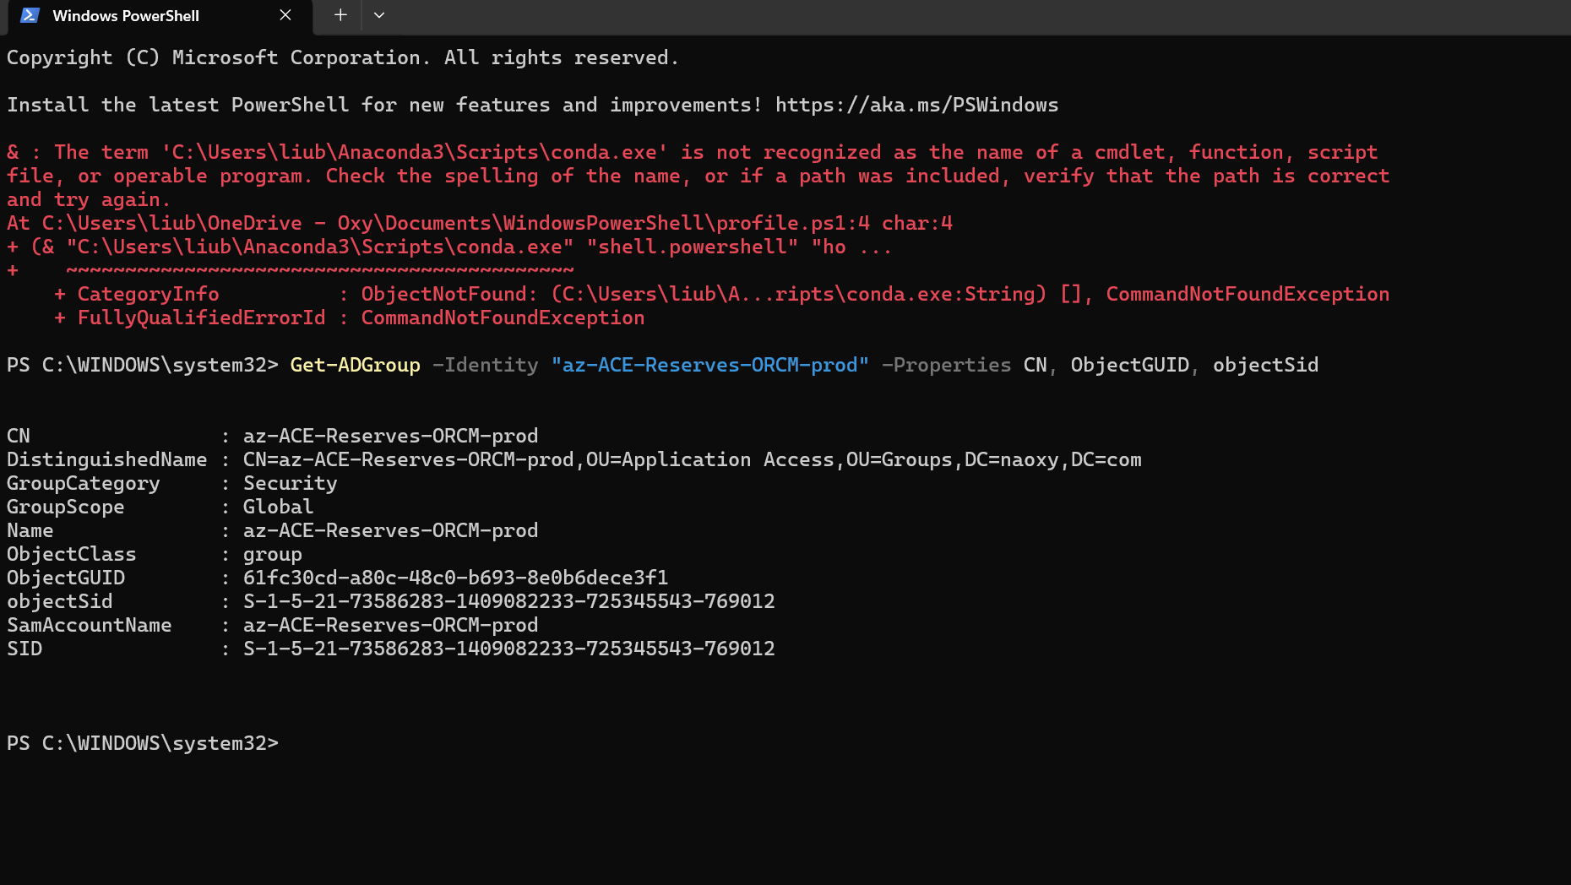
Get-ADGroup -Identity "az-ACE-Reserves-ORCM-prod" -Properties CN, ObjectGUID, objectSid

Slide 17


